Slide 1

CSC415 Operating System Principles
Mass-Storage Structure
Professor Hao Yue
Fall 2017

Slide 2
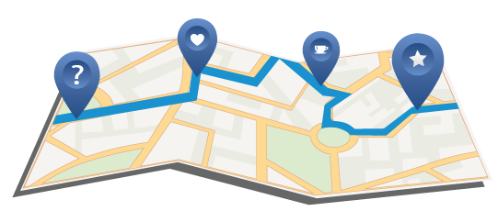
Outline
Overview
Disk Structure
Disk Scheduling
Disk Management

Slide 3
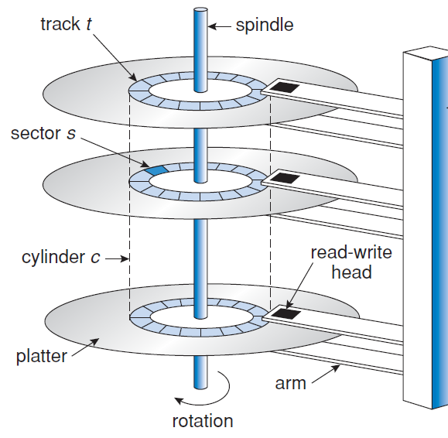
Overview
Hard Disks
Disk platter
Two surfaces are covered with a magnetic material that can store information
The surface is logically divided into circular tracks, which are subdivided into sectors
Disk arm
Move all read-write heads as a unit above each surface of every platter
Cylinder: the set of tracks at the same arm position

Slide 4
Overview
Rotations Per Minute (RPM)
When the disk is in use, a drive motor spins at high speed
Transfer rate
The rate at which data flow between the drive and the computer
Positioning time (random-access time)
Seek time: the time to move the disk arm to the desired cylinder
Rotational latency: the time for the desired sector to rotate to the disk hand

Slide 5
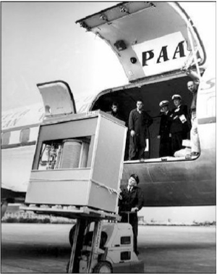
Overview
First commercial disk drive
IBM RAMDAC computer included the IBM Model 350 disk storage system (1956)
Access time ≤ 1 second

Slide 6
Disk Structure
Hard disk drives are addressed as large one-dimensional array of logical blocks, where the logical block is the smallest unit of transfer
The one-dimensional array of logical blocks is mapped onto the sectors of the disk sequentially
Sector 0 is the first sector of the first track on the outermost cylinder
Mapping proceeds in order through that track, then through the rest of the tracks in that cylinder, and then through the rest of the cylinders from outermost to innermost
The number of sectors per track is not a constant on some drives

Slide 7
Disk Scheduling
Use disk drives efficiently: minimize data access time and maximize disk bandwidth
Access time
Seek time
Minimize seek time = minimize seek distance
Rotational latency
Disk bandwidth: the total number of bytes transferred, divided by the total time between the first request for service and the completion of the last transfer
Disk scheduling algorithms
Disk I/O requests are placed in the queue for the disk drive
Choose which request to service next to minimize seek time

Slide 8
Disk Scheduling
Several different disk scheduling algorithms exist
Illustrate scheduling algorithms with a request queue with requests for I/O to blocks on cylinders
98, 183, 37, 122, 14, 124, 65, 67
The disk header is initially at cylinder 53.

Slide 9
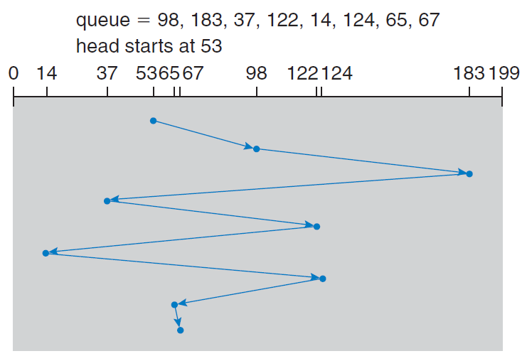
FCFS
First-come, first-served (FCFS) algorithm
Fair, but does not provide the fastest service (Head movement = 640)

Slide 10
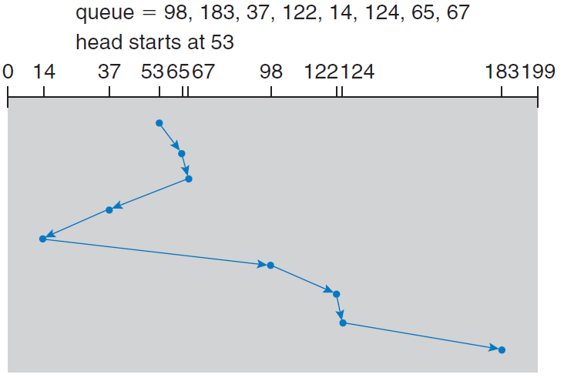
SSTF
Shortest-Seek-Time-First (SSTF) algorithm
Select the request with the least seek time from the current head position (Head movement = 236)

Slide 11
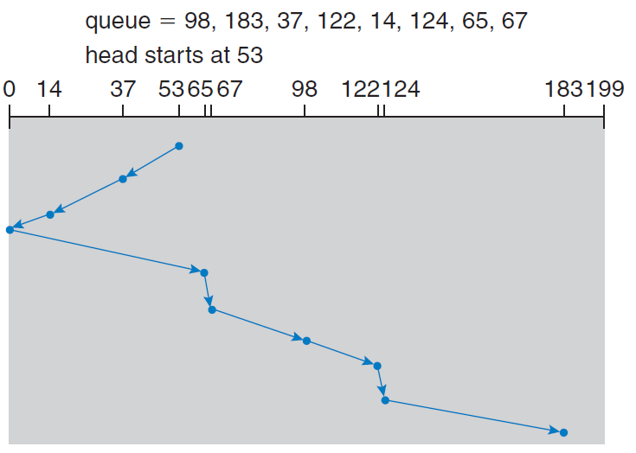
SCAN
SCAN algorithm
Start at one end of the disk and moves toward the other end. At the other end, the direction of movement reversed

Slide 12
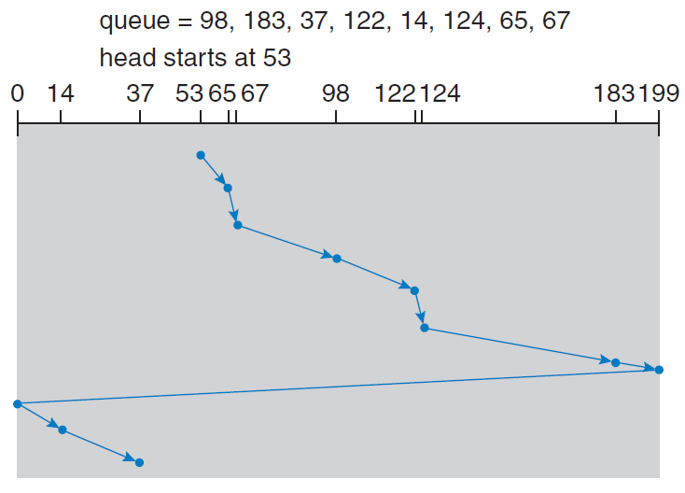
C-SCAN
Circular SCAN (C-SCAN) algorithm
When the head reaches the other end, returns to the beginning of the disk

Slide 13
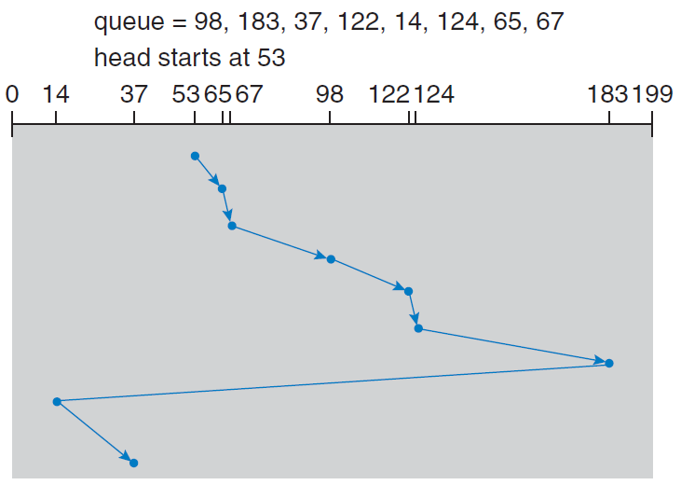
LOOK
LOOK and C-LOOK scheduling algorithms
SCAN and C-SCAN move the disk arm across the full width of the disk
LOOK and C-LOOK only move the arm as far as the final request in each direction

